Slide 1
Can Sparse Memory updates allow LLMs to continually learn?
CSCI 601-771 (NLP: Self-Supervised Models)
Jalil, Zhengguang, Dengjia, Jonathan
https://self-supervised.cs.jhu.edu/fa2025/

Slide 2

Challenge of Continual LLM Learning
Continuel Learning = models that can be taught like students
Experience + human feedback -> makes model smarter overtime
Two subproblems in continual learning of LLMs :
Generalization:
What is the right update from new data?
Need augmentations to disambiguate the intended concept.
Real-world learning requires active self-supervision.
Integration:
Update without forgetting
Must overwrite outdated info but preserve reusable knowledge.
Requires sparse, targeted parameter updates
What properties do we want?
Target Updates
(touch minimal parameters)
High Capacity
(lifetime of learning)
Adaptive integration
(what to overwrite/preserve)

Slide 3
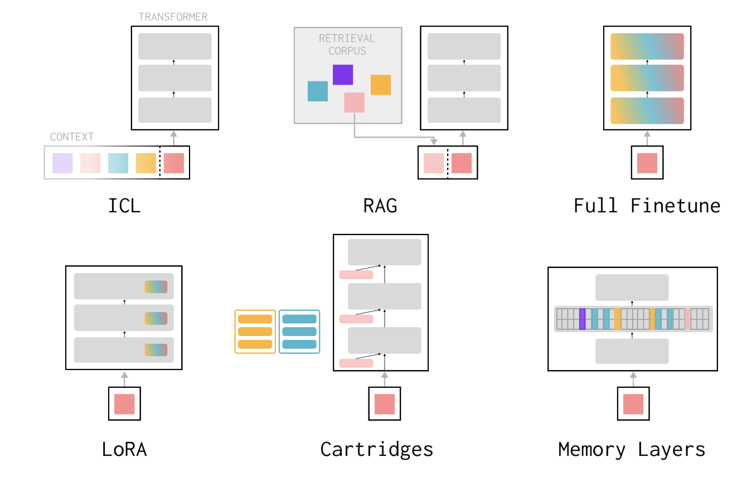
Current Continual Learning Approaches
Non-Parametric approaches:
ICl: short-term, suffers from context rot.
RAG: high capacity but no compression into weights.
Parametric approaches:
Finetuning+Replay: prevents forgetting but not scalable.
Parameter-Efficient Finetuning (cartridge): targeted but low capacity; unclear task boundaries.
MoE: large capacity; finer-grained experts help.
Memory Layers: many small experts enabling targeted, scalable lifelong learning.

Slide 4



Proposed Solution: Sparsity
Structural Sparsity: The Capacity Fix
Learning Sparsity: The Update Fix
Memory Layers at Scale: A dedicated, sparse architecture providing billions of extra parameters to store new knowledge cheaply.
Sparse Memory Finetuning: An intelligent, selective update rule that modifies only specific memory slots, mitigating interference.

Slide 5
Memory Layers at Scale
Vincent-Pierre Berges, Barlas Oğuz, Daniel Haziza, Wen-tau Yih, Luke Zettlemoyer, Gargi Ghosh

Slide 6
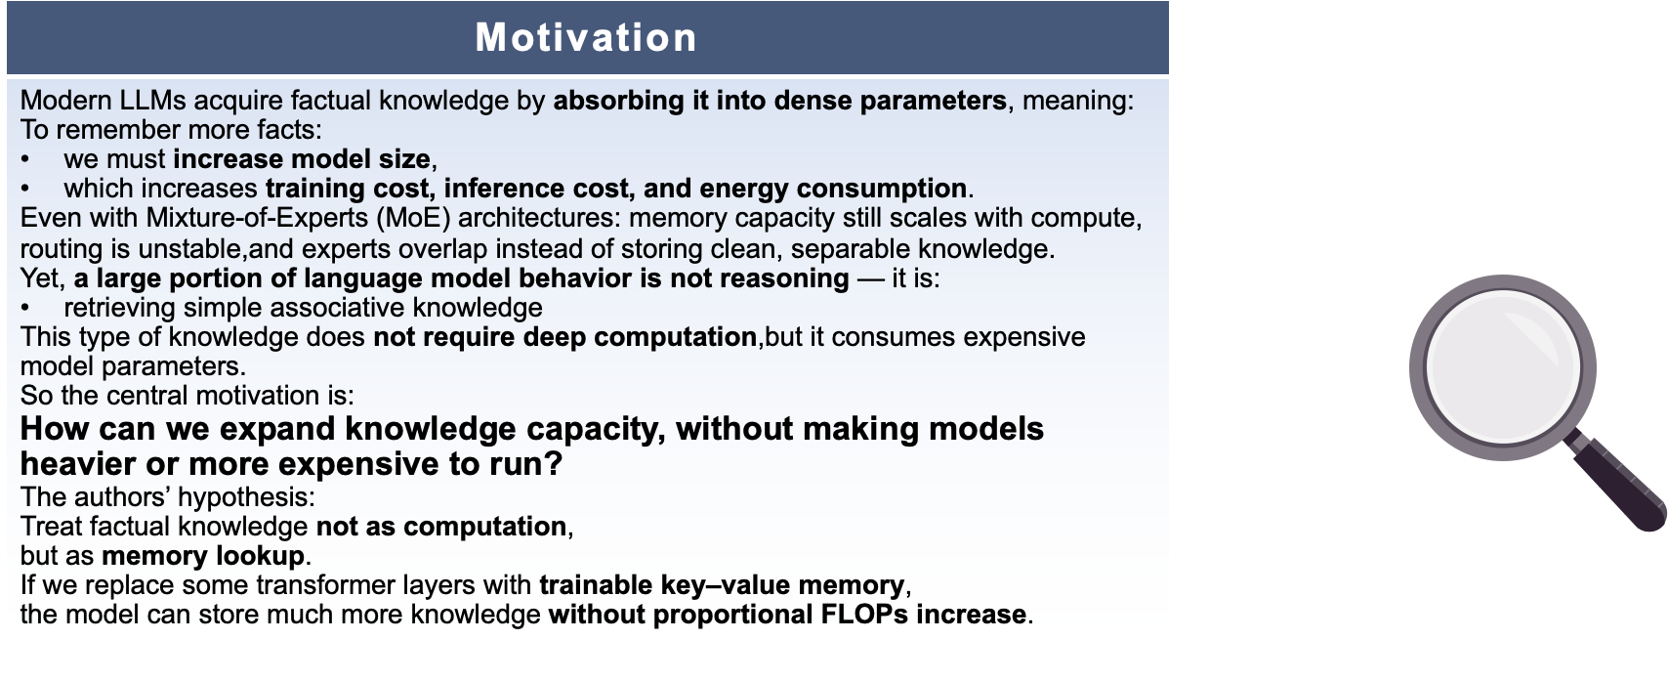
Problem Statement / Motivation

Slide 7

Problem Statement / Motivation
Problem: How LLMs Store Facts
LLMs memorize facts in dense parameters.
More facts → larger models → higher training / inference cost and energy use.
Even with Mixture-of-Experts (MoE), memory capacity still roughly scales with compute; routing can be unstable and experts overlap.
But a lot of what LLMs do is simple fact retrieval, not deep reasoning.
How can we expand knowledge capacity without making models heavier or more expensive to run?

Slide 8
Problem Statement / Motivation
The Author’s Hypothesis:
Treat factual knowledge not as computation, but as a memory lookup.
Replace some transformer layers with trainable key-value memory, so the model can store much more knowledge without proportional FLOPs increase

Slide 9
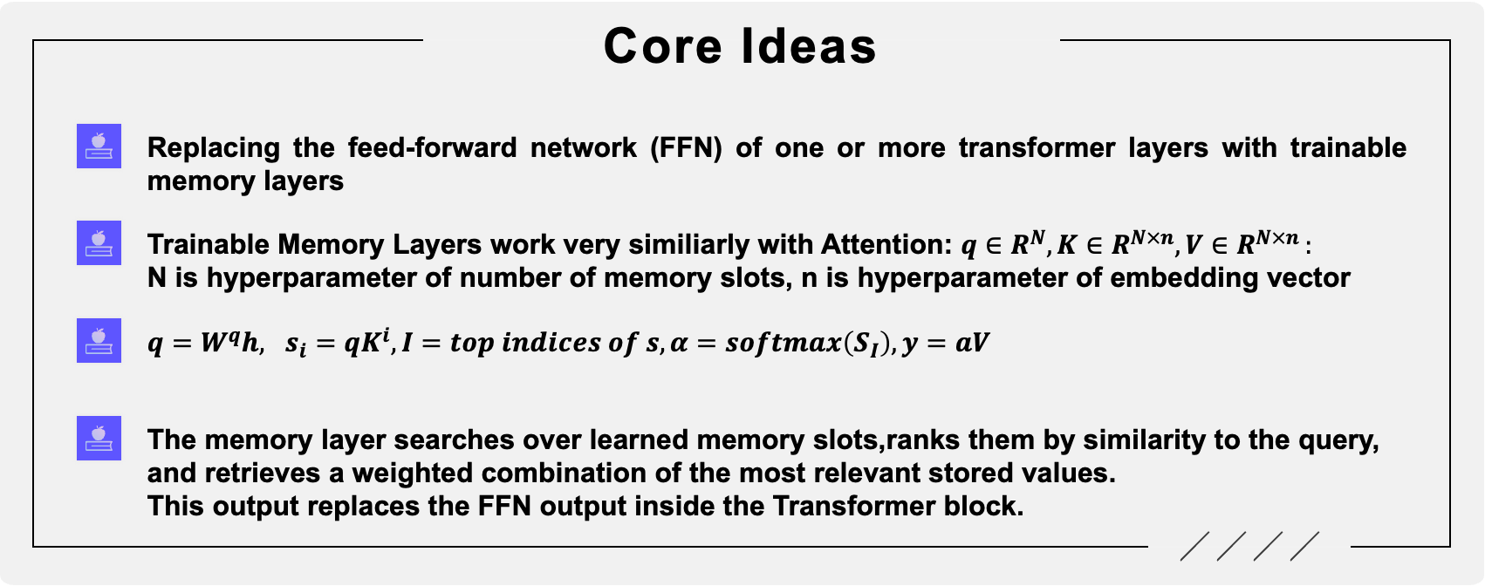
Core Idea / Method

Slide 10
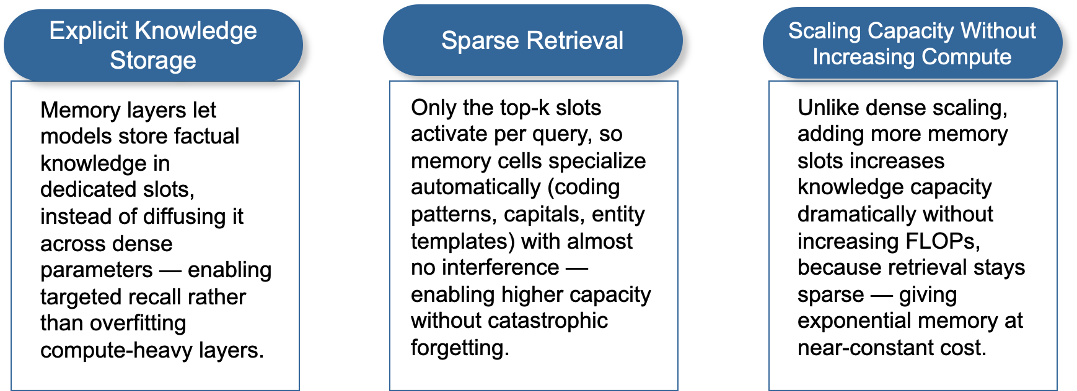
Intuitively Why Memory Layers Work?

Slide 11
Intuitively Why Memory Layers Work?
Explicit Knowledge
Storage
Sparse Retrieval
Scaling Capacity, Not Compute
- Facts live in dedicated memory slots, not tangled in all the weights.
- Easier to store, update, and recall specific pieces of knowledge.
- For each query, only top-k slots are activated.
- Slots naturally specialize (e.g., capitals, entities, code patterns) with little interference.
- We can add more memory slots to store more facts.
- Retrieval stays sparse, so FLOPs barely increase while knowledge capacity grows.

Slide 12
Scaling / Implementation Details
Product-Key Lookup (Efficient Retrieval)
Scaling memory layers is limited by expensive nearest-neighbour search over large key spaces.
The model avoids this by factorizing keys into two smaller “half-key” sets. Queries are split and matched against these smaller sets to retrieve top-k candidates efficiently.
Final key scores are computed by combining matches from the two half-key sets, approximating full-space lookup without instantiating it.
Parallel Memory (sharding across GPUs)
Memory layers are large, so lookup is sharded across GPUs to scale efficiently.
Each GPU stores only part of the embeddings, performs lookup on its shard, and aggregates partial results.
This avoids materializing full embeddings on any device, keeping activation memory manageable.
The approach runs in its own parallel group, independent of other model-parallel schemes.

Slide 13
Scaling / Implementation Details
Product-Key Lookup (Efficient Retrieval)
Naïve lookup over a huge key space is too expensive.
Factorize keys into two smaller key tables; split each query accordingly.
Search each table separately, then combine pairs of matches to approximate full-space top-k at much lower cost.
Parallel Memory (sharding across GPUs)
The memory table is too large for one GPU, so we shard it across GPUs.
Each GPU stores a slice of the table, does local lookup, then we aggregate partial results.
Avoids materializing the full table on one device and works in its own parallel group, alongside other model-parallel schemes.

Slide 14
Scaling / Implementation Details
Shared Memory Across Layers
They use a shared pool of memory parameters across all memory layers in the network. That is — multiple memory-augmented layers reference the same key/value tables.
They find empirically that replacing more than a few FFN layers with memory helps, but beyond a certain point, further replacement hurts performance (suggesting a balance between dense + sparse layers). In their experiments, up to 3 memory layers was beneficial; beyond that it degraded performance.
Performance & Stability Improvements (Engineering)
They also introduce an enhanced variant called Memory+, which adds an additional small projection + gating + non-linearity (e.g. SiLU) after retrieval to stabilize training and improve performance.
For backward pass, gradient updates to the huge embedding tables (values, keys) can collide (many outputs may map to the same slot). They compare different strategies: atomic-add accumulation, row-level locks, and a “reverse-indices / atomic-free” method that maps token IDs to embedding indices to aggregate gradients safely. For high-dimensional embeddings (>128 dims), reverse-indices or lock-based updates are faster than atomic-add.

Slide 15
Scaling / Implementation Details
Shared Memory Across Layers
All memory layers share one global key–value table (a common memory pool).
This cuts parameters and encourages reuse of the same stored facts.
Empirically, replacing ~1–3 FFN layers with memory helps; more than that hurts, so a mix of dense + memory layers works best.
Performance & Stability Improvements
Memory+ adds a tiny projection + gate (e.g., SiLU) after lookup to stabilize training and improve accuracy.
For the huge embedding table, they use a batched, atomic-free gradient aggregation scheme instead of naive atomic adds, reducing contention and making updates more stable and efficient.

Slide 16
Experimental Setup
Baselines
Dense Transformer Models: The paper primarily compares its method against standard dense Llama-style transformer baselines, trained at multiple scales (134M → 1.3B parameters).
Mixture-of-Experts (MOE): Each feed-forward layer contains multiple “experts,” but only a subset of experts is activated for a given input.→ This increases model capacity without proportionally increasing compute.
PEER Model (He, 2024):Works similarly to memory layers but retrieves a pair of embeddings that form a rank-1 dynamic feed-forward layer.→ Serves as an alternative parameter augmentation method.
Evaluation Benchmarks
Factual Question Answering: NaturalQuestions, TriviaQA
Multi-hop / reasoning QA: HotpotQA
World knowledge & comprehension: MMLU, HellaSwag, OBQA, PIQA
Programming / code generation: HumanEval, MBPP
Reporting Metrics: Common accuracy measures are used—Exact Match or F1 for QA, and pass@1 for coding tasks.
Negative log-likelihood (NLL) is also reported to analyze language modeling quality.

Slide 17
Experimental Setup
Baselines
Dense Transformers: LLaMA-style models at multiple sizes (≈134M → 1.3B parameters).
Mixture-of-Experts (MoE): FFN layers with many experts; only a few are active per token → higher capacity at similar compute.
PEER (He, 2024): Retrieves a pair of embeddings to form a rank-1 dynamic FFN layer → alternative way to add parameters.
Evaluation Benchmarks
Factual QA: NaturalQuestions, TriviaQA
Multi-hop / reasoning QA: HotpotQA
World knowledge / comprehension: MMLU, HellaSwag, OBQA, PIQA
Code generation: HumanEval, MBPP
Metrics: Exact Match / F1 for QA, pass@1 for coding, and NLL for language-model quality.

Slide 18
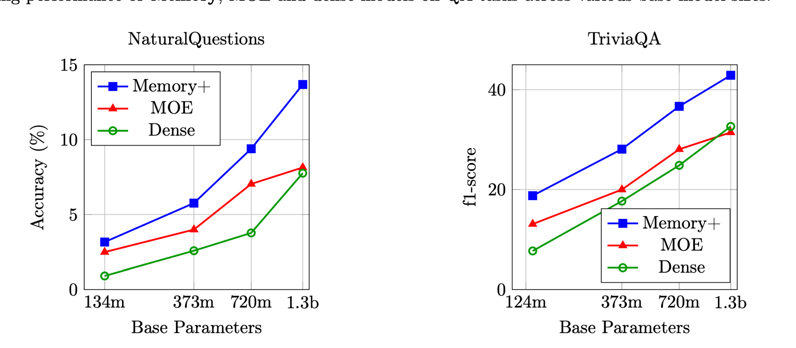
Scaling Results-Same # of parameters
Parameter budgets are deliberately matched across architectures.
Memory models replace FFN layers with a shared memory table, keeping total parameters unchanged.
Memory+ adds additional memory layers but reuses the same shared memory, so its footprint stays the same.
PEER is configured with a slightly different half-key size to reach similar total parameters.
MOE picks the minimum number of experts required to match Memory’s parameter scale.
Therefore, all models have nearly identical parameter counts and compute—the difference lies only in how the parameters are allocated and organized.

Slide 19
Scaling Results - Same # of parameters
All models are tuned to have similar total parameters & FLOPs.
Memory models replace some FFN layers with a shared memory table (Memory+ adds more memory layers but reuses the same table).
PEER and MoE are configured to match this parameter scale (adjusted key size / number of experts).
Because budgets are matched, the curves on the right show how we allocate parameters (dense vs. MoE vs. memory), not how many we use. Memory+ consistently wins under the same parameter budget.

Slide 20
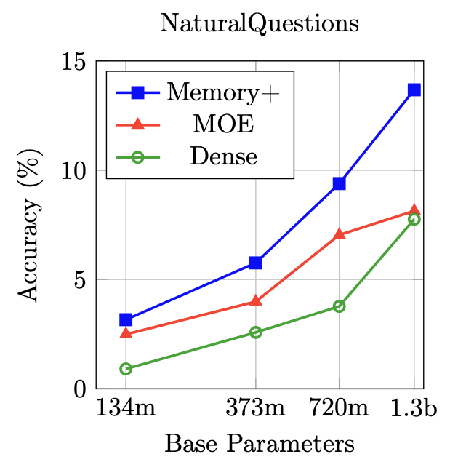
Scaling Results - Scaling Memory Params
Scale MOE, Dense baseline, Memory+ to approximately-equal parameter counts
Compare performance on datasets

Slide 21
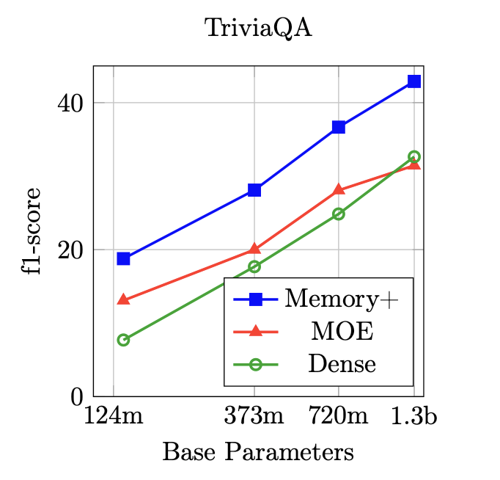
Scaling Results - Scaling Memory Params
Scale MOE, Dense baseline, Memory+ to approximately-equal parameter counts
Compare performance on datasets

Slide 22
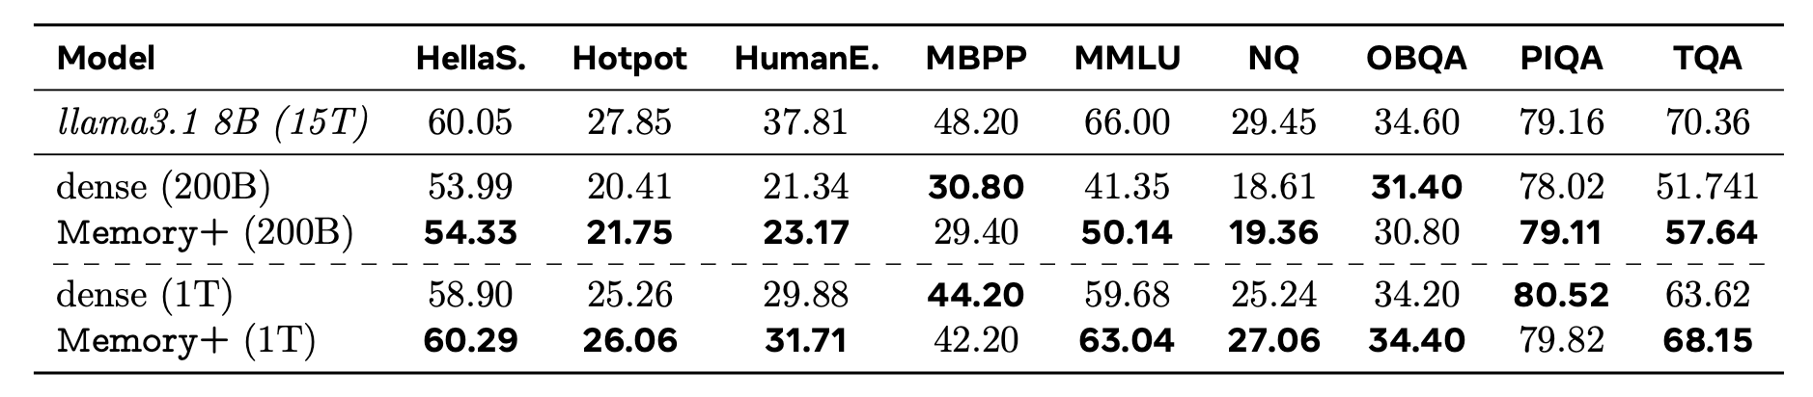
Scaling Results-Results at 8B Scale
Memory+ significantly improves data efficiency (models learn facts faster)
Approaches Llama 3.1 (trained on 15T tokens) when trained on only 1T tokens
When trained on 200B tokens, already outperforms baseline models (without memory layers, just standard FFN)

Slide 23
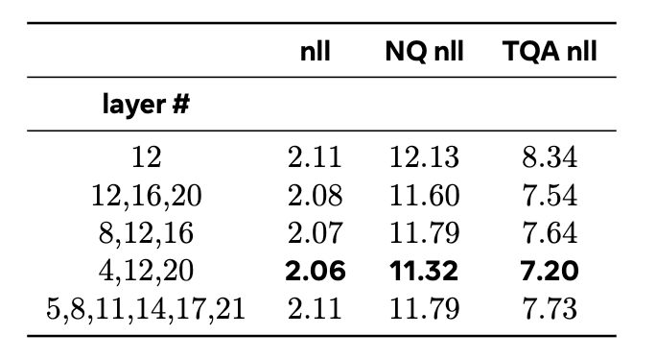
Model Ablations: FFN layers
Vanilla Memory paradigm: A single memory layer
Memory+: Multiple memory layers.
Best results: 3 memory layers at centered spaces, with large strides (layers 4, 12, 20)
“Sweet spot” - take advantage of faster learning, without losing too many dense layer parameters.

Slide 24
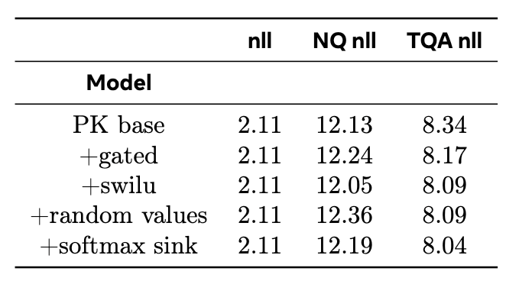
Model Ablations: FFN layers
Various architectural tweaks
Authors preferred swilu as it gave consistent gains

Slide 25
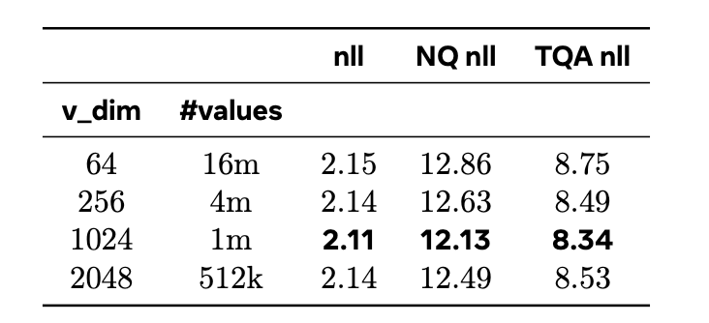
Model Ablations: Key/value dimensions
Value dimension tradeoff: Higher dimension, fewer value outputs in memory.
Default: Value dimension = model dimension (1024)
Authors find default to be optimal

Slide 26
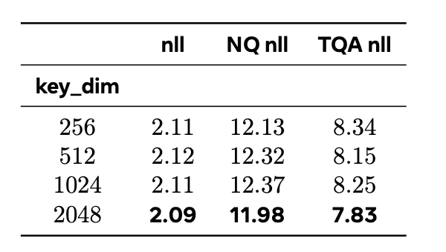
Model Ablations: Key/value dimensions
Increasing key dimension to 2048 boosts performance, but adds more dense parameters, breaking parameter-matched comparisons
Ambiguous: Better architecture, or more parameters?
Selected key dimension: Half of the base-model dimension (comparison fairness)

Slide 27
Ablations: Summary
Memory layer placement
Optimal performance: 3 layers, spaced evenly at large stride
Architectural tweaks
Swilu - most consistent gains; their only adopted tweak
Key/Value dimension choices
Value dimension: Default (1024, same as model dimension) best.
Key dimension: Increasing it boosts performance, but adds more dense parameters. Authors fix it at ½ base model dimension for fair comparison.

Slide 28
Recap - What This Paper Does
Problem: LLMs store facts in dense weights → scaling knowledge = scaling compute & cost.
Idea: Replace some FFN layers with trainable key–value memory layers.
Intuition:
Explicit memory slots for facts
Sparse top-k retrieval per query
Add more memory slots without big FLOP increase
Engineering: product-key lookup, sharded memory across GPUs, shared global memory table, and Memory+ tweaks for stability.

Slide 29
Recap - Key Results & Takeaways
Under matched parameter & FLOP budgets, Memory+ > dense and MoE on QA benchmarks.
Scaling memory size improves factual accuracy and lowers NLL.
At 8B scale, Memory+ trained on 1T tokens approaches Llama-3.1 8B trained on 15T.
Best configuration: a few well-placed memory layers and default value dim; memory is a promising way to grow knowledge without just making the model bigger.

Slide 30
Continual Learning via Sparse Memory Finetuning
Jessy Lin , Luke Zettlemoyer, Gargi Ghosh, Wen-Tau Yih, Aram Markosyan, Vincent-Pierre Berges, Barlas Oğuz, ICLR 2025)

Slide 31
The Problem: Catastrophic Forgetting
Static Models after Deployment
Once deployed, LLMs are typically frozen in time. Updating them on new data streams causes Catastrophic Forgetting.
This happens because standard training updates dense parameters shared across all knowledge, causing massive interference. New facts overwrite old ones.
What is needed: For models to learn how to organize its knowledge through end-to-end gradient updates, achieving selective token/parameter updates.

Slide 32
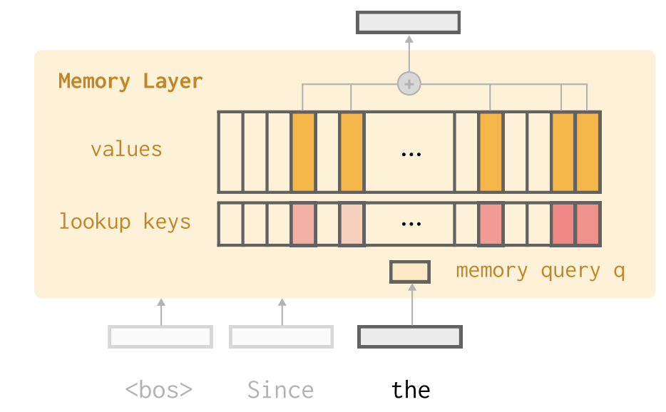
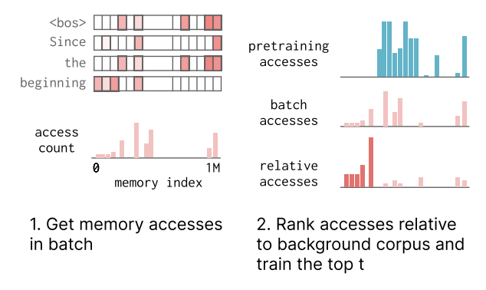
Solution: Sparse Memory Finetuning
The whole method is based on emory layer(last paper)
SMFT uses TF-IDF score to select memory slots in memory layer(this paper)

Slide 33
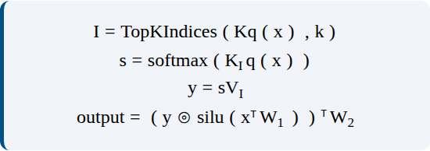
Methodology: Sparse Architecture
The Forward Pass:
Step 1: Retrieve top-k indices based on query projection.
Step 2: Compute scores using Softmax on retrieved keys.
Step 3: Compute weighted output and apply gating.

Slide 34
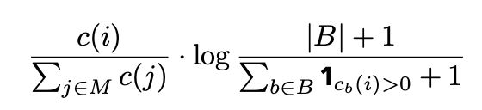
Methodology: The Update Rule
Intelligent Selection (TF-IDF)
Does not just update all active parameters.
Filter them using a TF-IDF score.
Prioritizes "knowledge-specific" slots
(high frequency in new data, low in general training data) and freezes "common" slots.

Slide 35
Experiment setup
Base Model Pretraining:
Built on the Memory Layers at Scale model.
Pretrained using the DCLM dataset
DCLM includes large QA + retrieval-style data sources:
Wikipedia passages
WikiQA
NaturalQuestions (NQ)
GSM8k (Math)
Model starts with strong factual + QA capabilities.
Continual Learning experiments:
TriviaQA Fact Stream
1,000 TriviaQA facts presented sequentially.
Measures acquisition vs retention of facts.
Document Chunk Stream
Sequential Wikipedia-style passage chuncks.
Learning evaluated on SimpleQA.

Slide 36
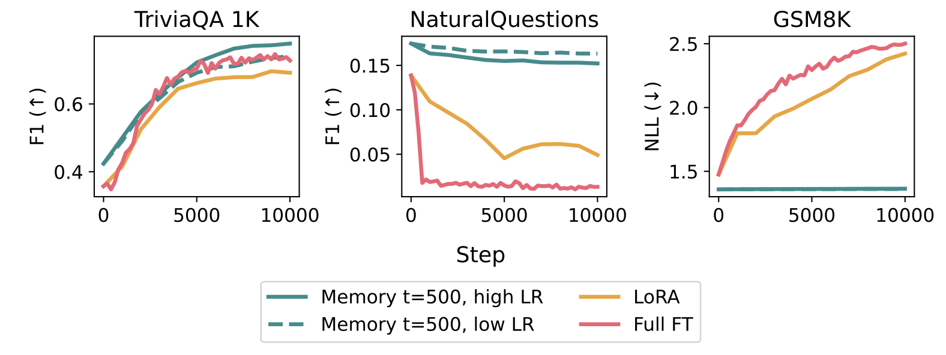
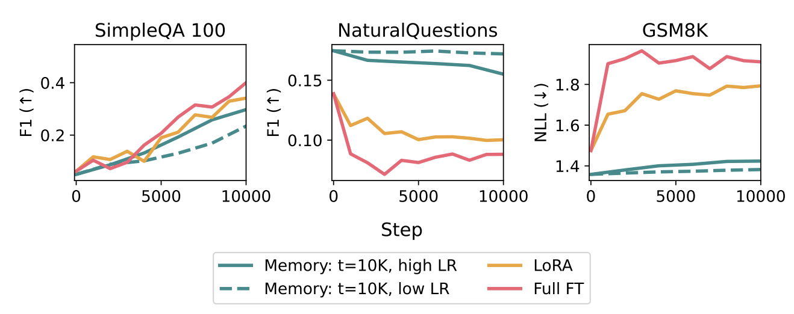
Results: Mitigating Forgetting
How much old QA knowledge is forgotten while learning new TriviaQA facts
Stability of QA performance when ingesting a continuous stream of document chunks
Result: SMFT significantly reduces catastrophic forgetting compared to baseline methods, outperforms Full Finetuning by ~8x in retention metrics.

Slide 37
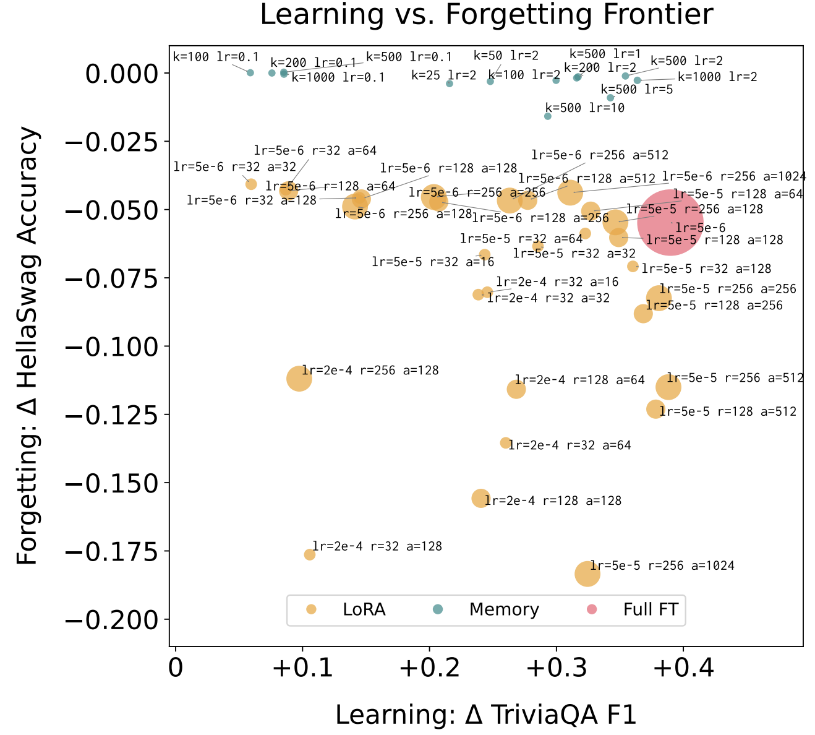
Pareto Efficiency: No Trade-off
SMFT reaches Pareto dominance with no tradeoff between acquisition and retention
Full Finetuning: High Acquisition, Low Retention
LoRA: Moderate Acquisition, Moderate retention
SMFT: High Acquisition, High Retention

Slide 38
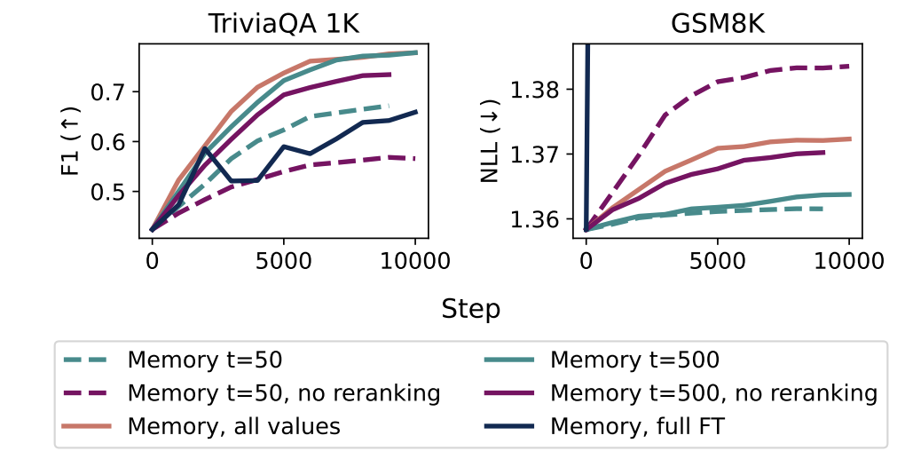
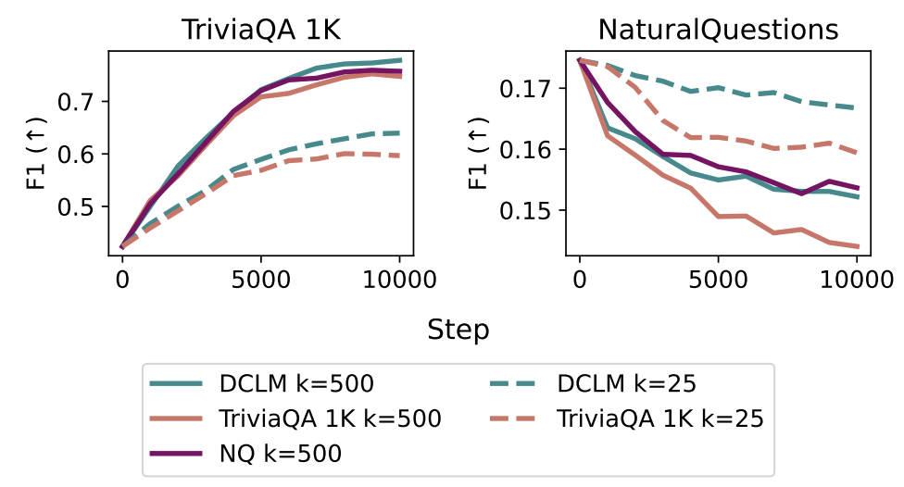
Ablation Study
Retrieval Sparsity alone is not enough; the update must be intelligent (using IDF).
IDF needs a representative background to correctly detect “common” slots.

Slide 39
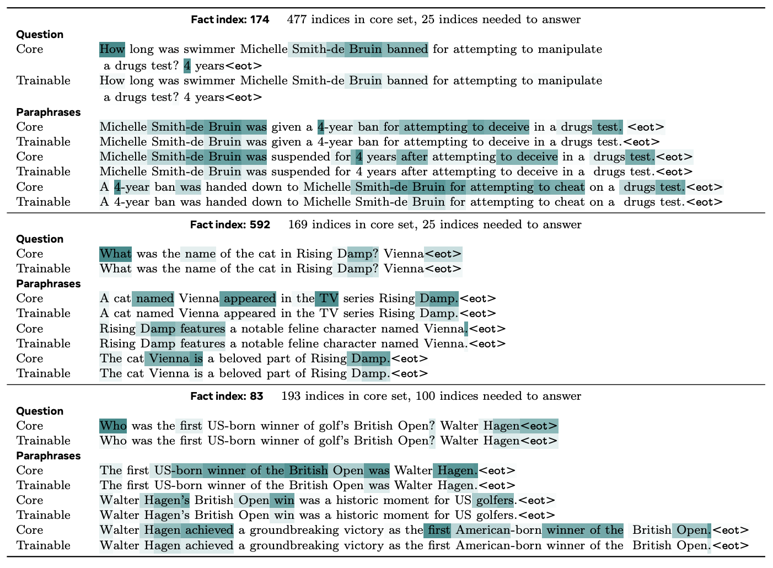
Understanding Memory Access
Core & trainable hit the same memory slots → shared semantics
Only 20–100 slots matter per fact → small trainable subset
Core meaning drives retrieval, not wording → semantic indexing
Knowledge stored sparsely and consistently
Enables SMFT: targeted slots = targeted updates

Slide 40
Takeaway + Discussion Questions
SMFT enables continual learning by updating only small, TF-IDF selected subset of memory slots, achieving high plasticity while maintaining stability
Paper demonstrates that forgetting comes from updating shared dense weights, not from lack of model capacity
Discussion Questions
Would the sparse update method work for acquiring dense reasoning skills (e.g., coding, math)?
Possible scores other than TF-IDF for filtering update slots?
Sparse Memory vs RL continual learning
What is different between MoE and memory layer
Limits of memory based continual learning

